Slide 2
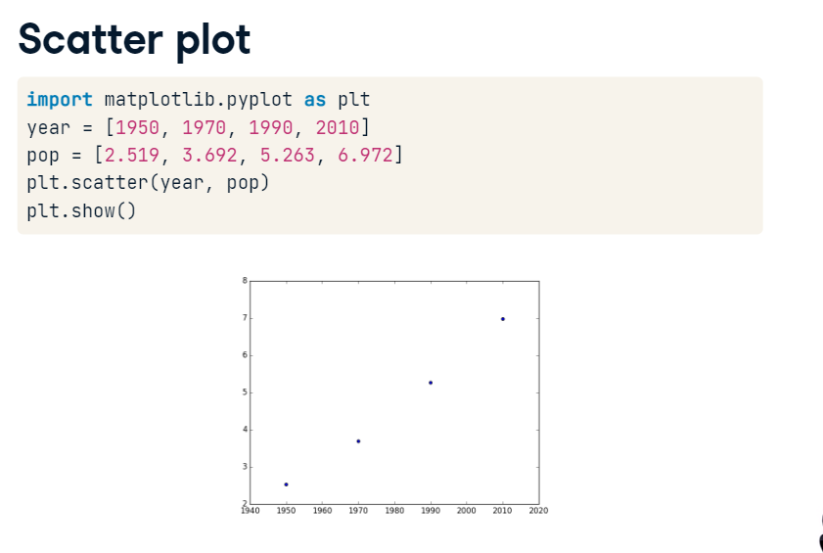

Slide 3
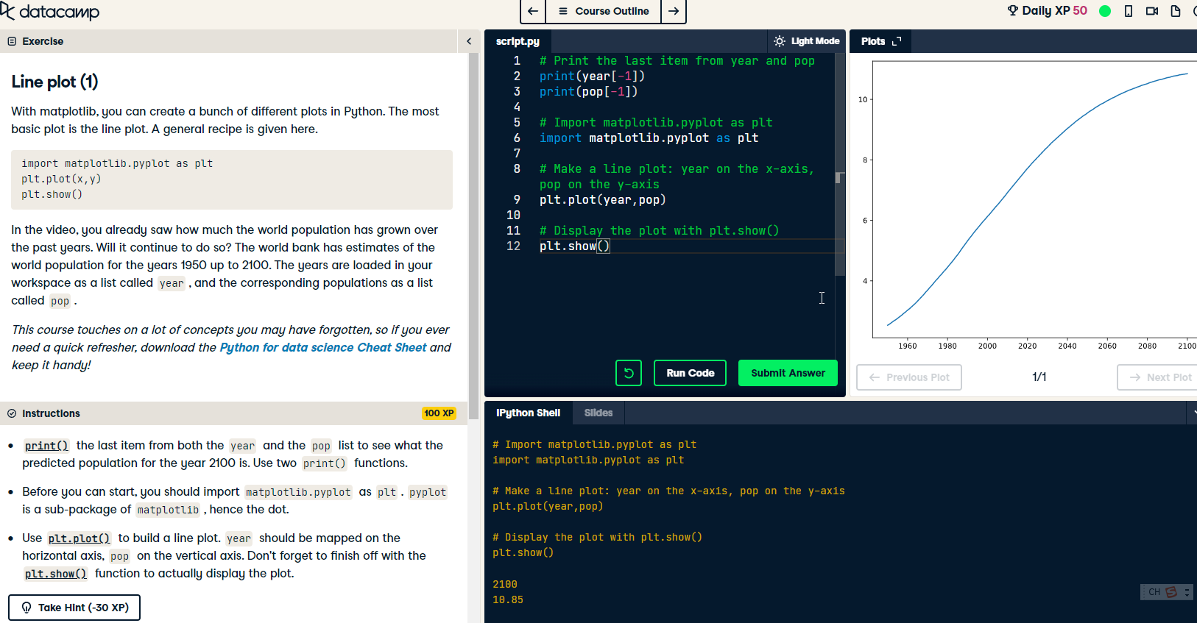

Slide 4
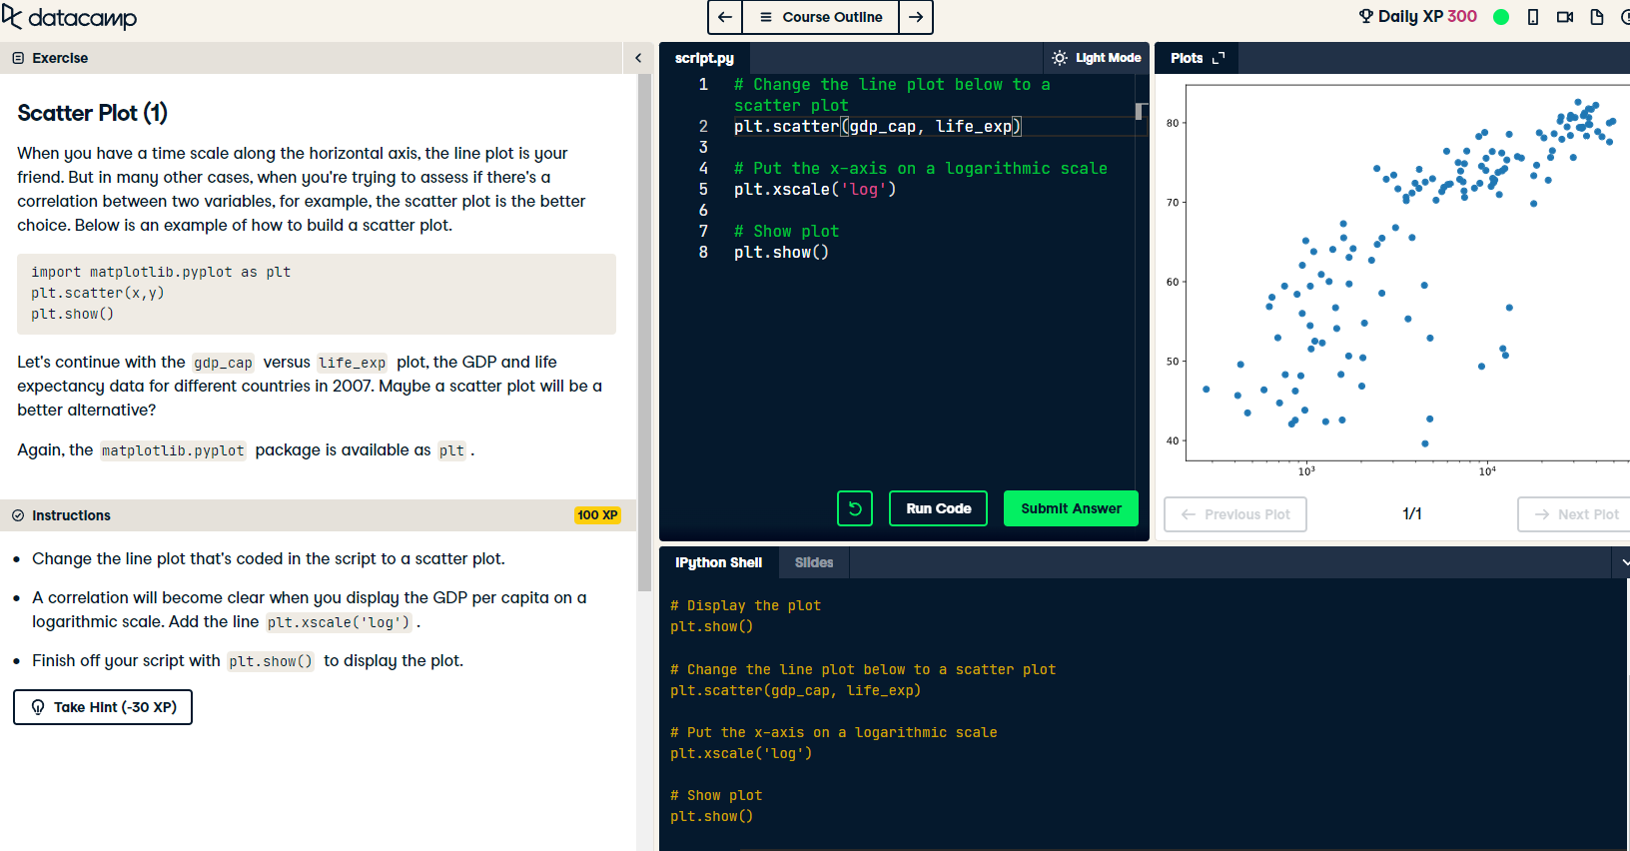

Slide 5
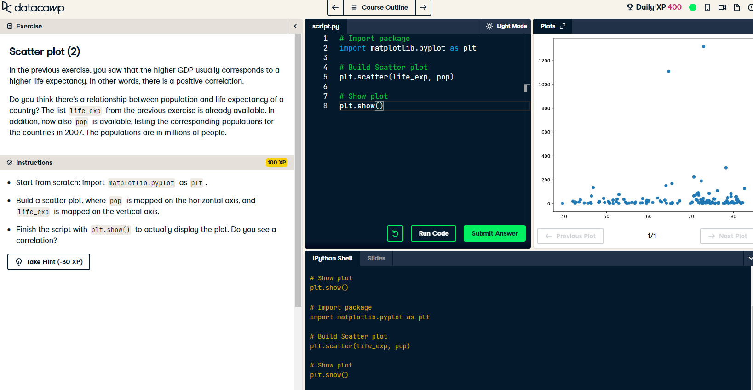

Slide 6
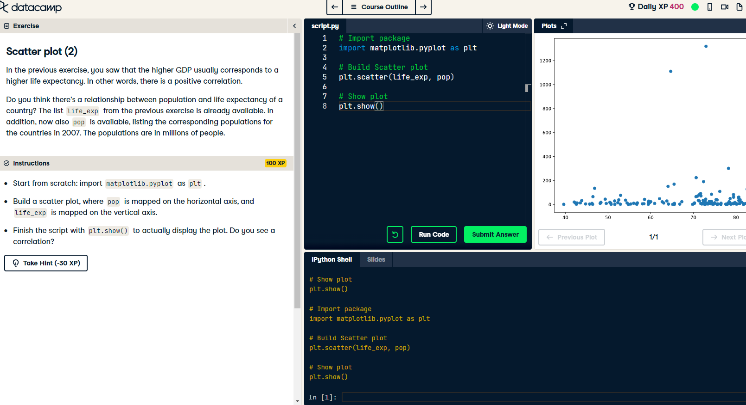

Slide 7


Slide 8
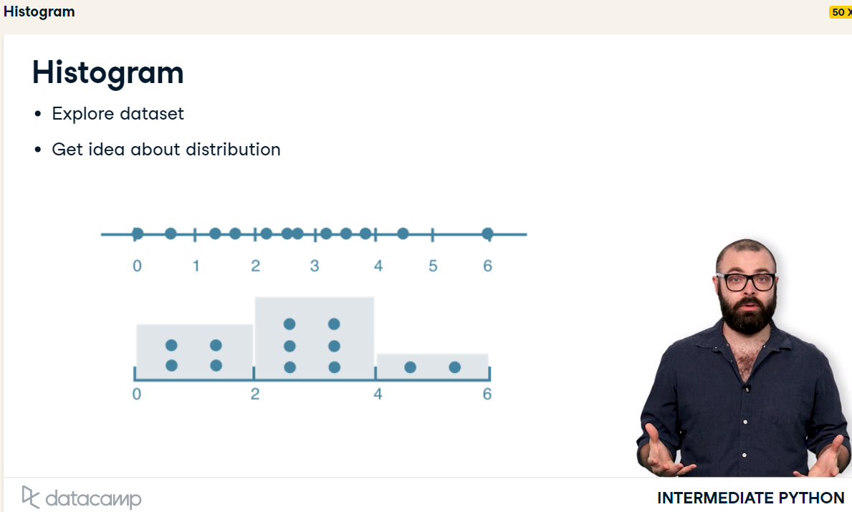

Slide 9
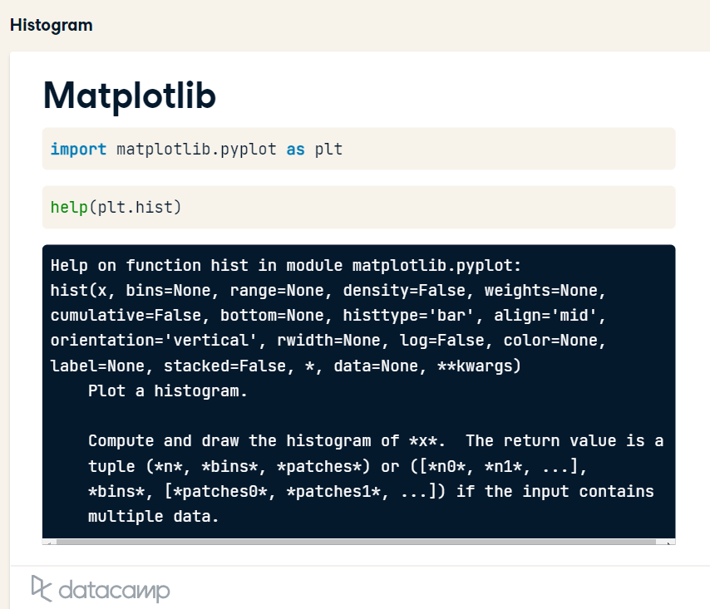

Slide 10
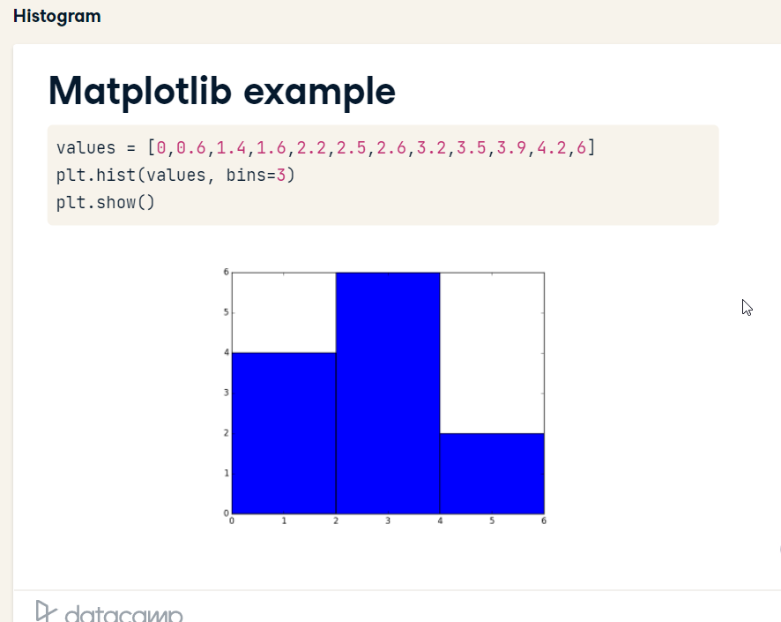
Useful to give a big picture

Slide 11
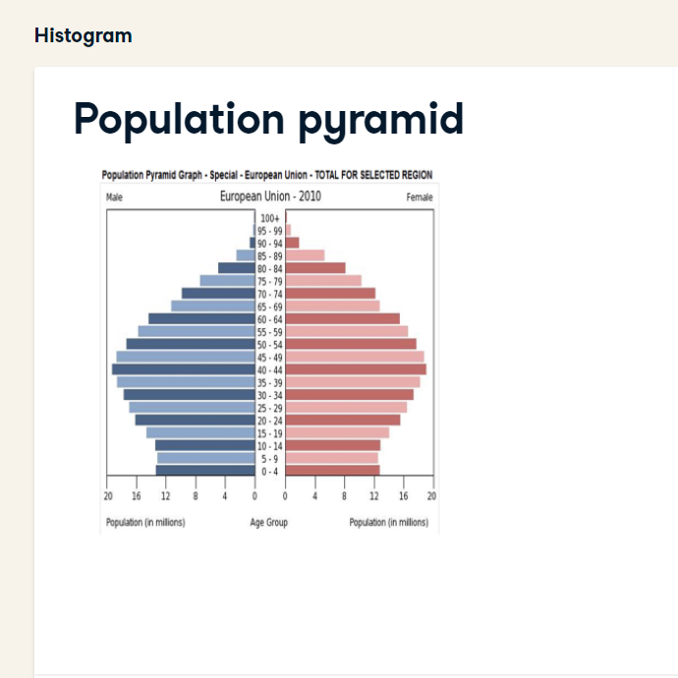

Slide 12
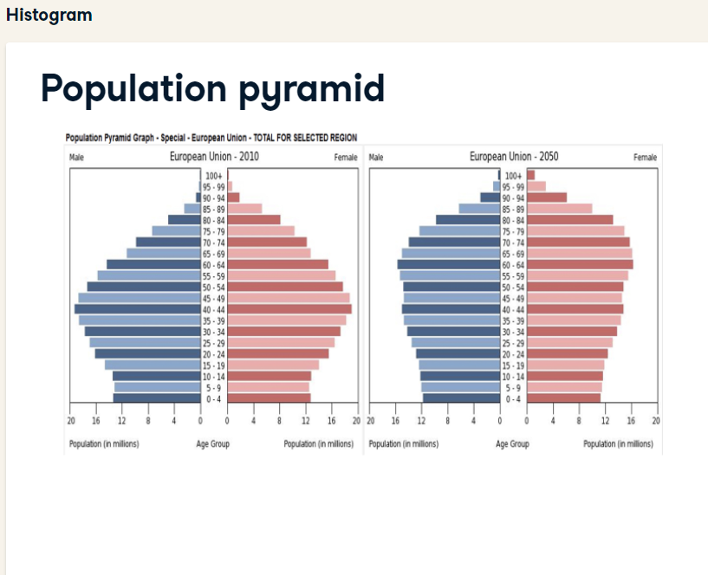

Slide 13
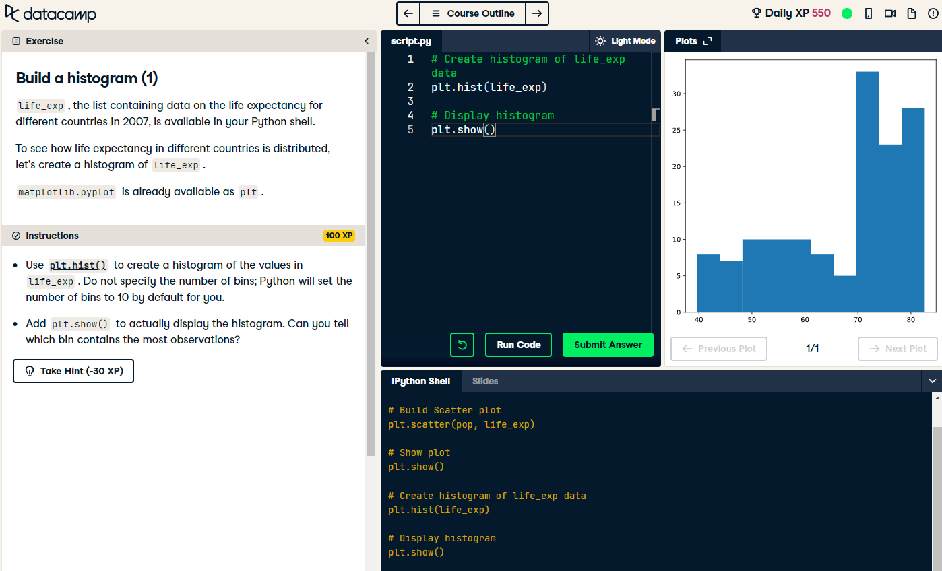

Slide 14
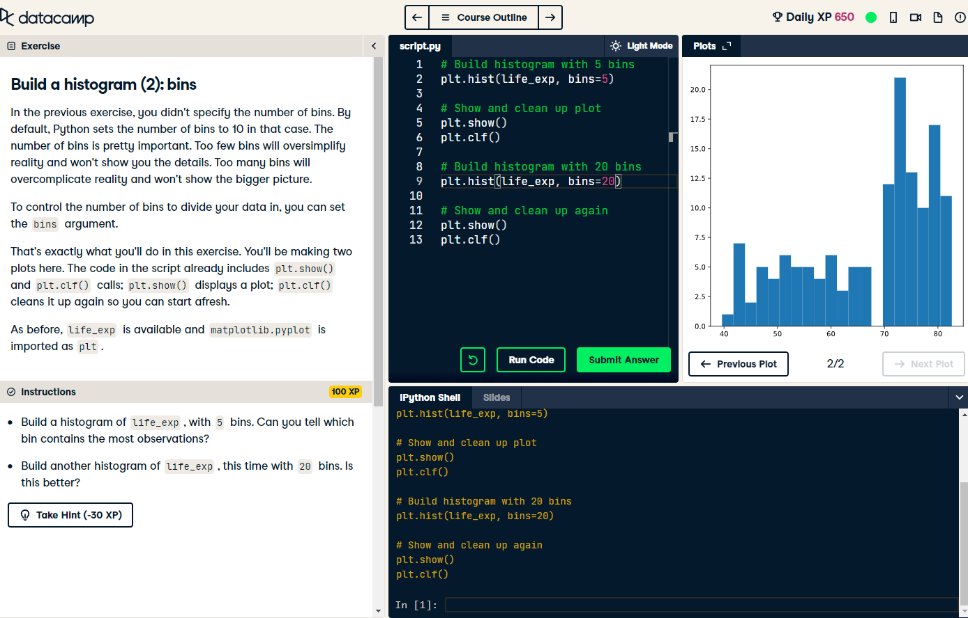

Slide 15
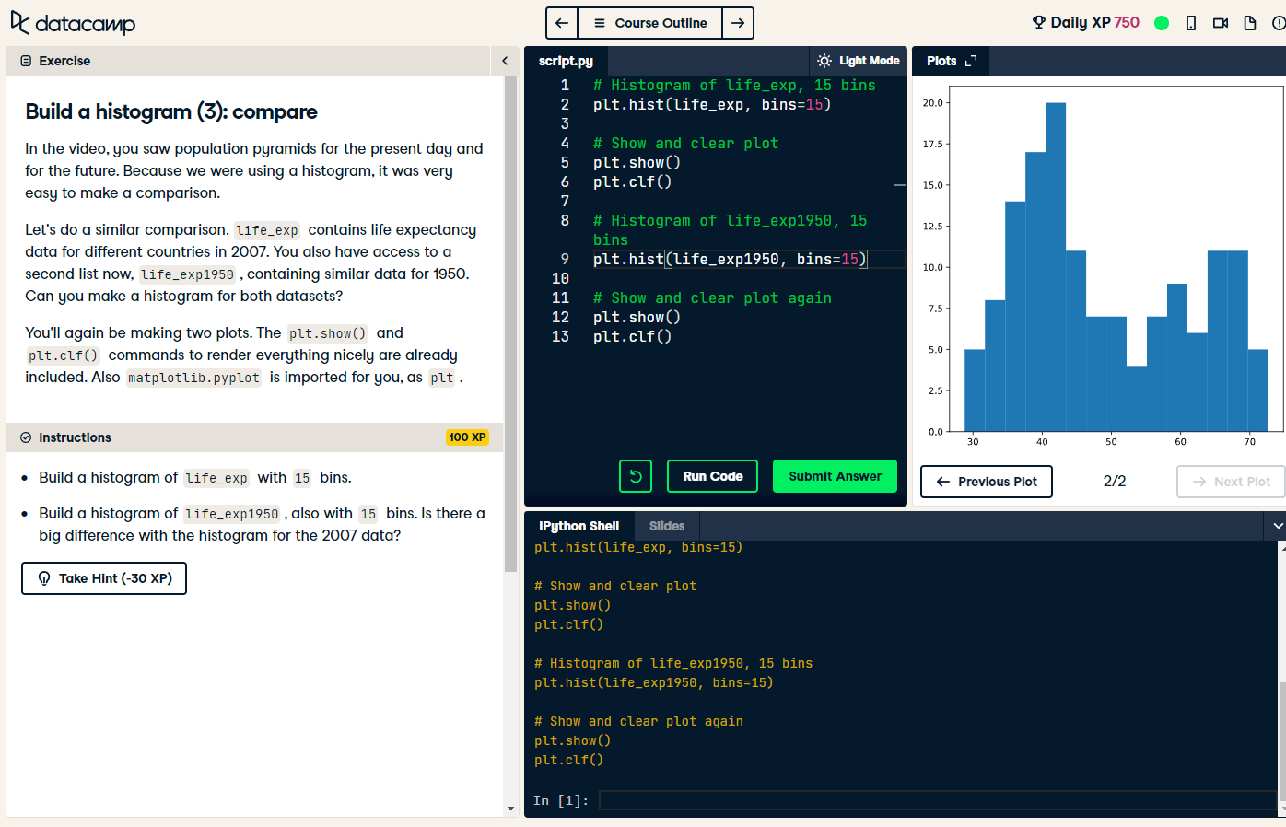

Slide 16
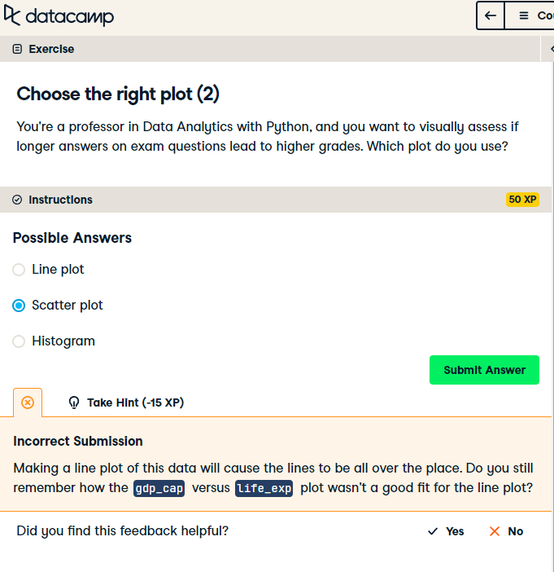

Slide 17


Slide 18
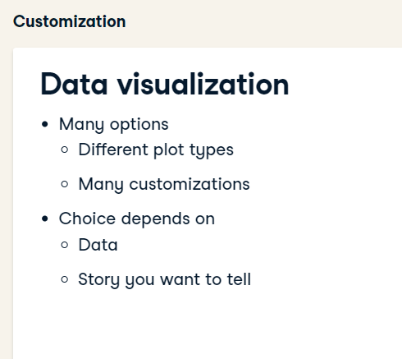

Slide 19
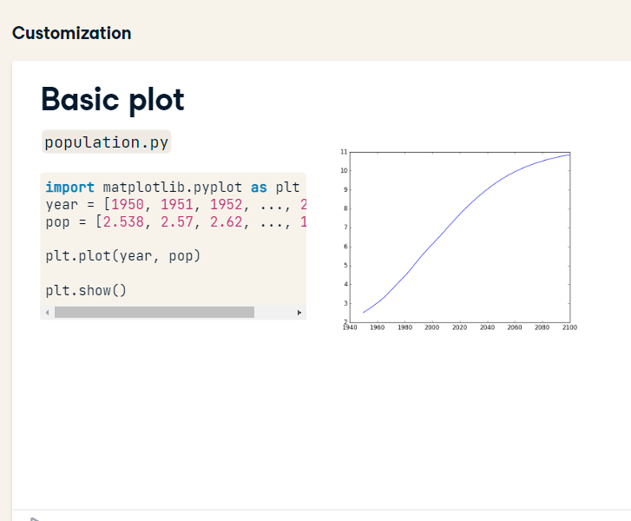

Slide 20
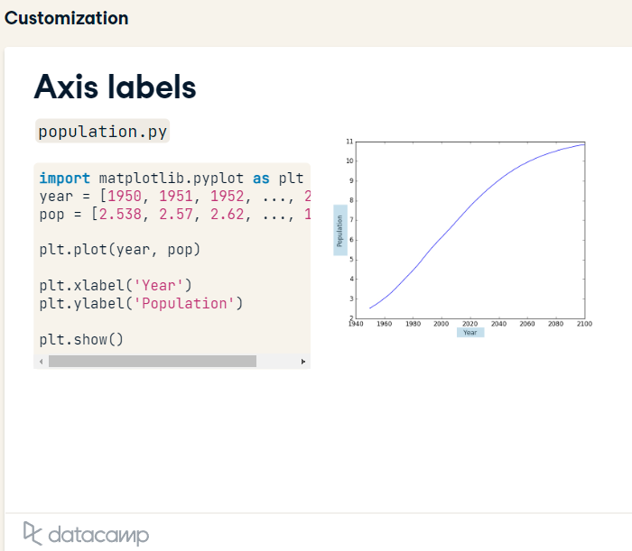

Slide 21
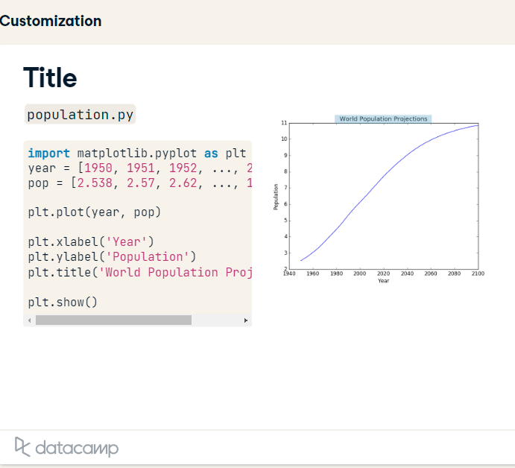

Slide 22
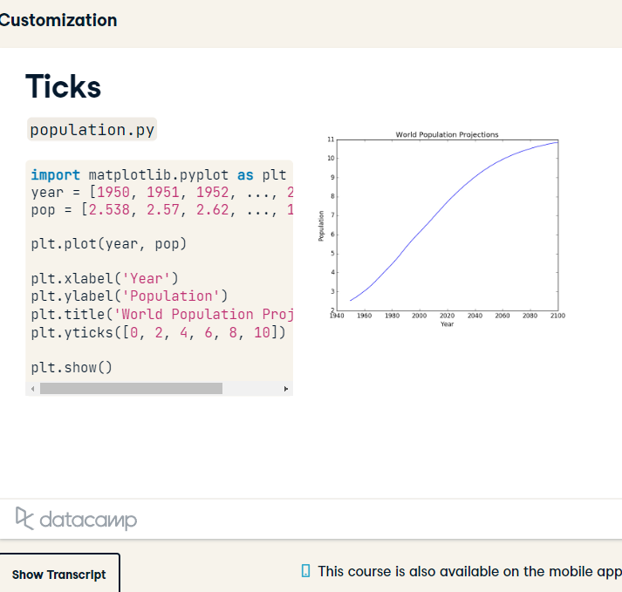

Slide 23
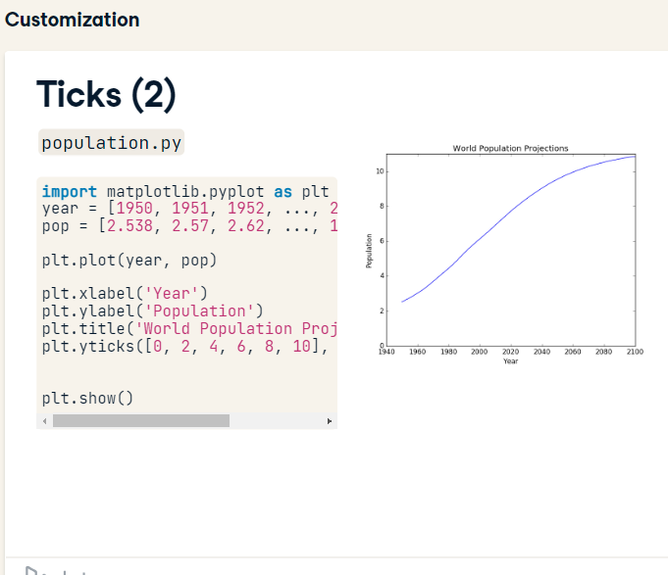

Slide 24
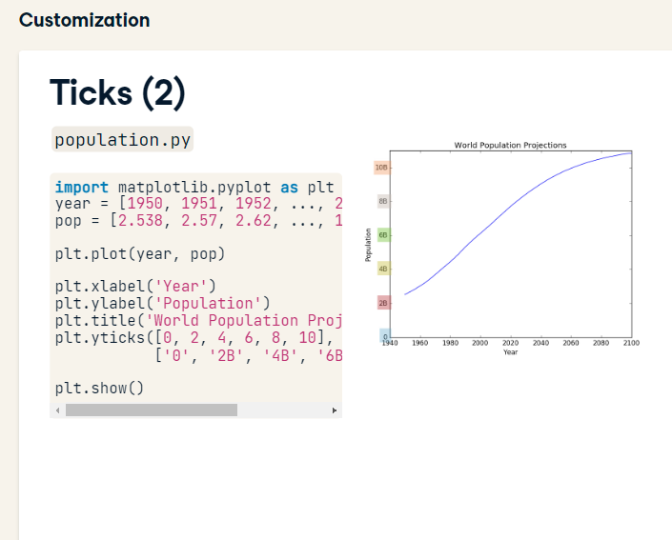

Slide 25
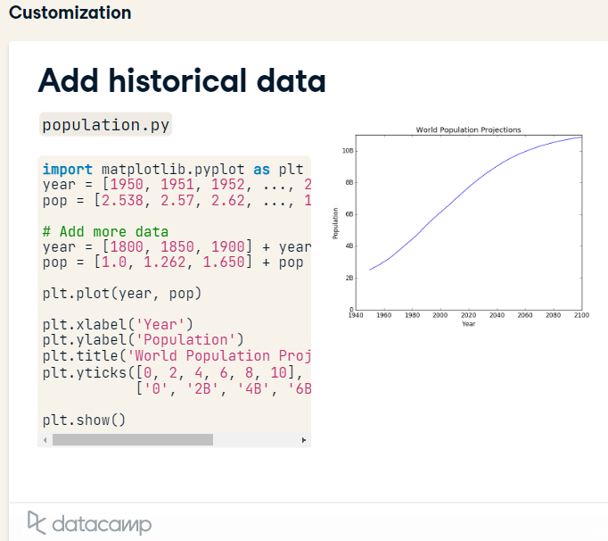
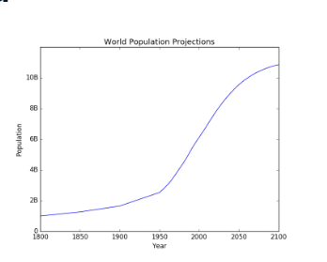

Slide 26
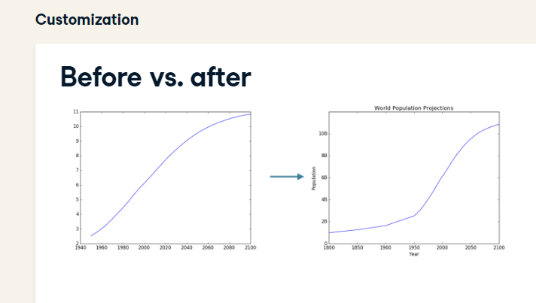

Slide 27
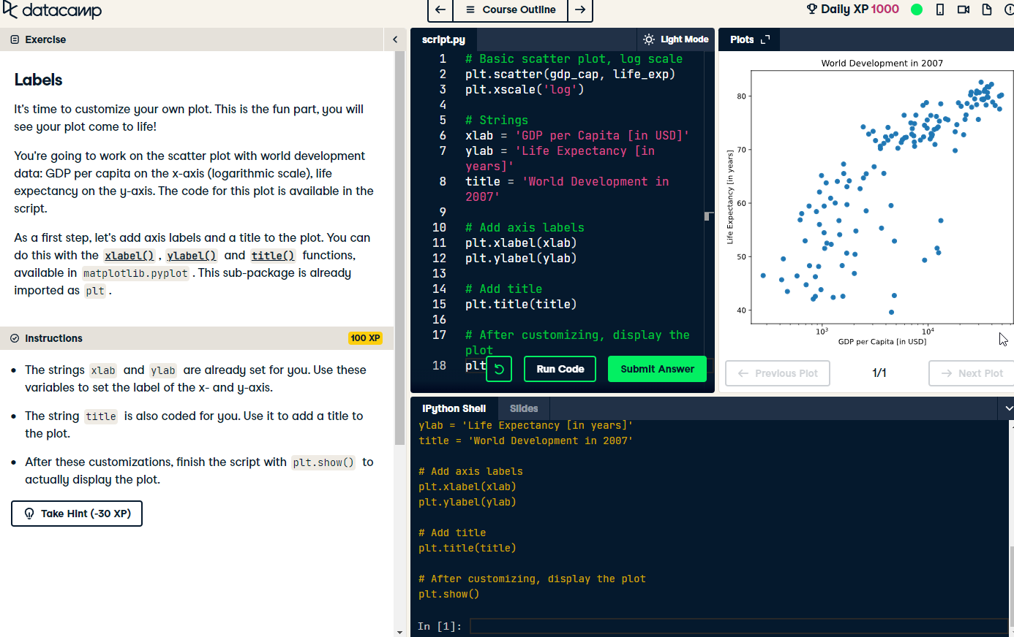

Slide 28
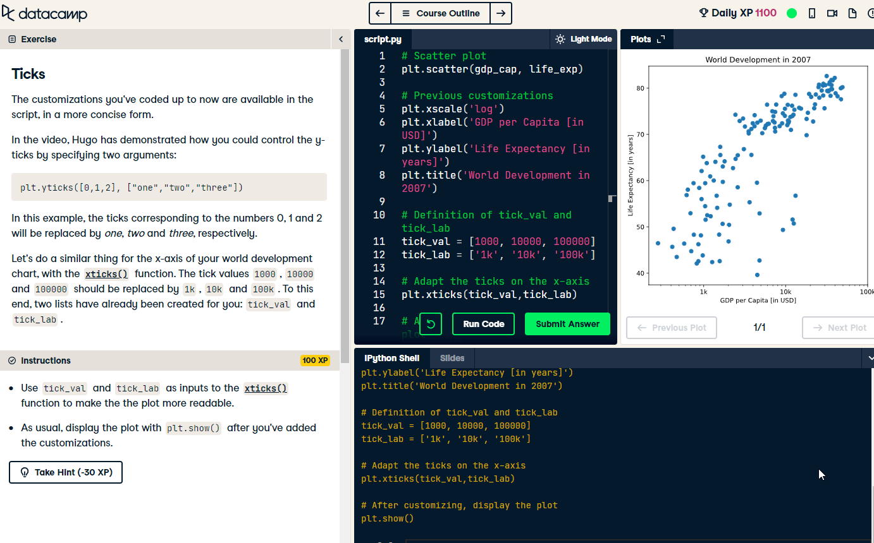

Slide 29
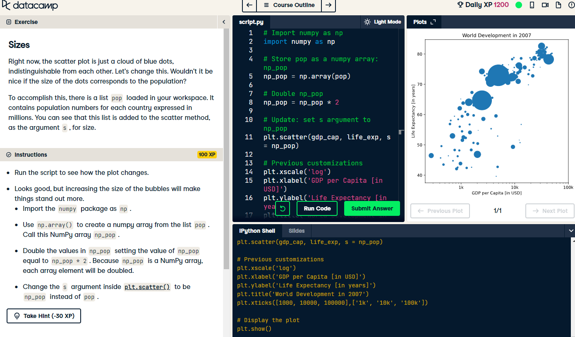

Slide 30
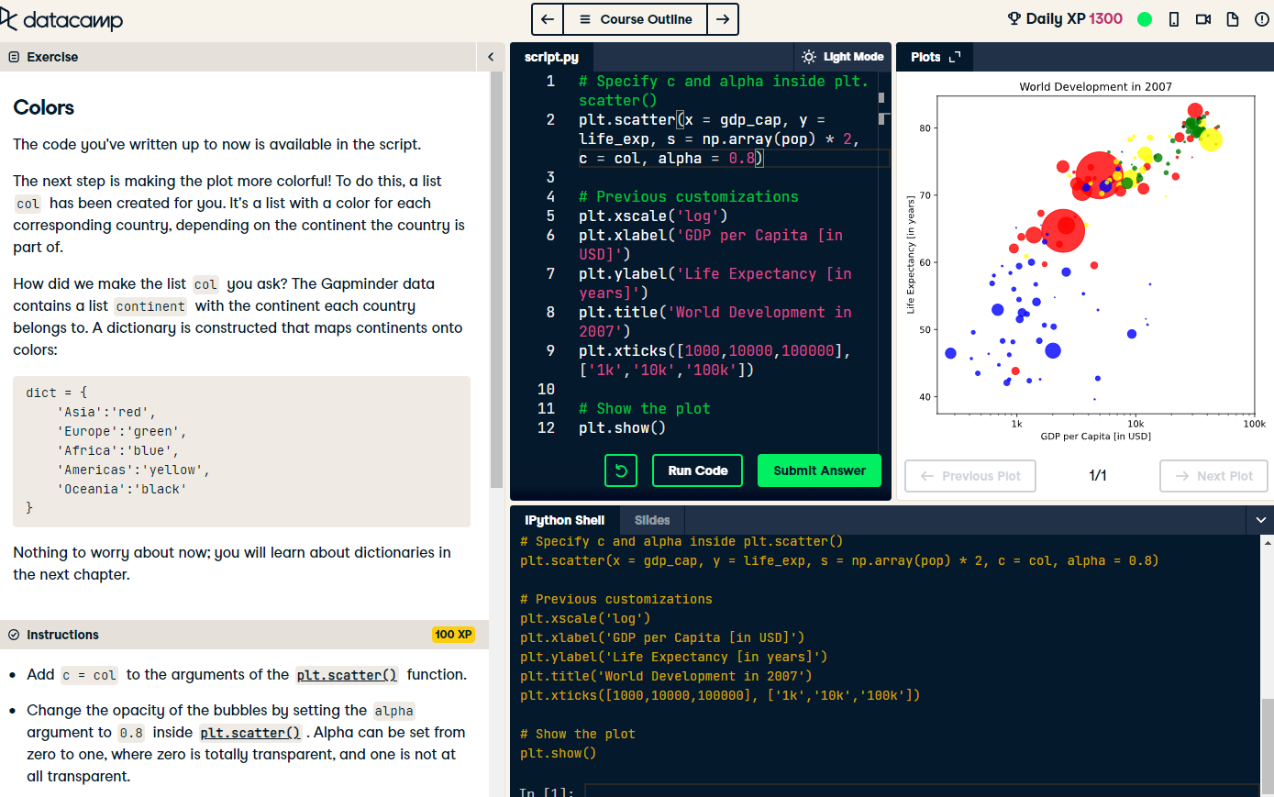

Slide 31
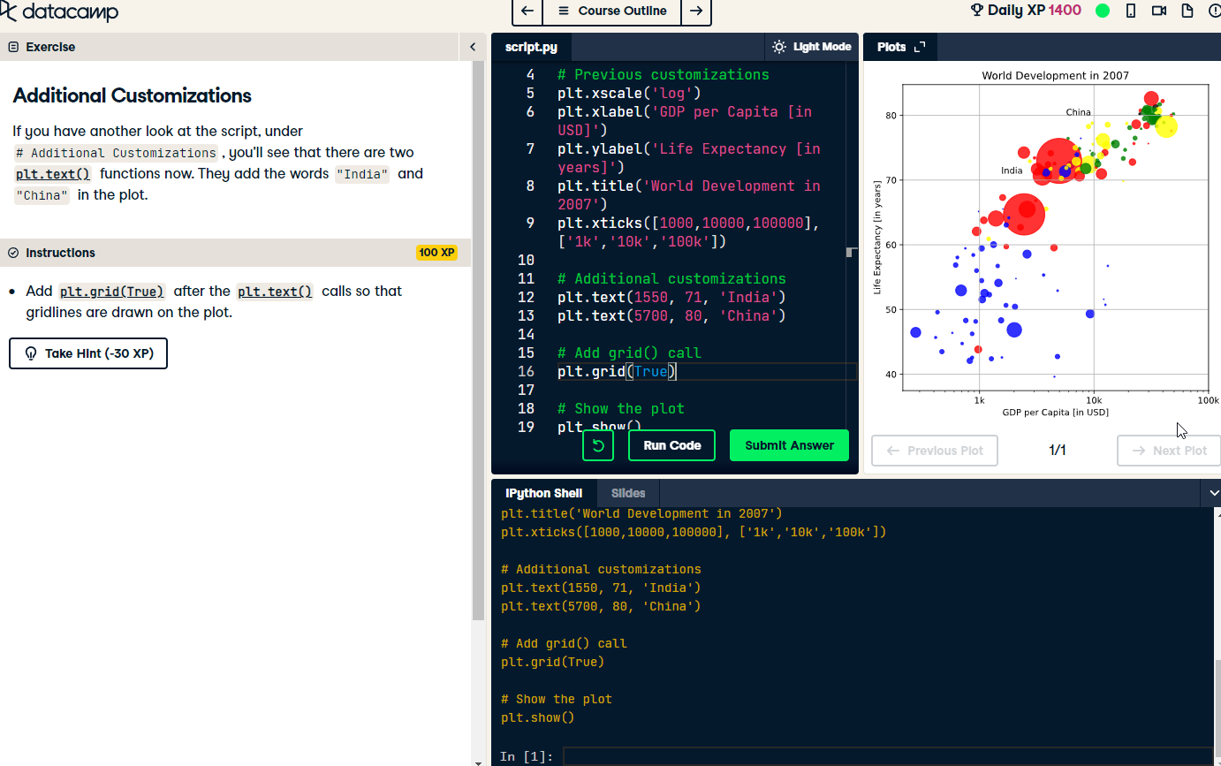

Slide 32
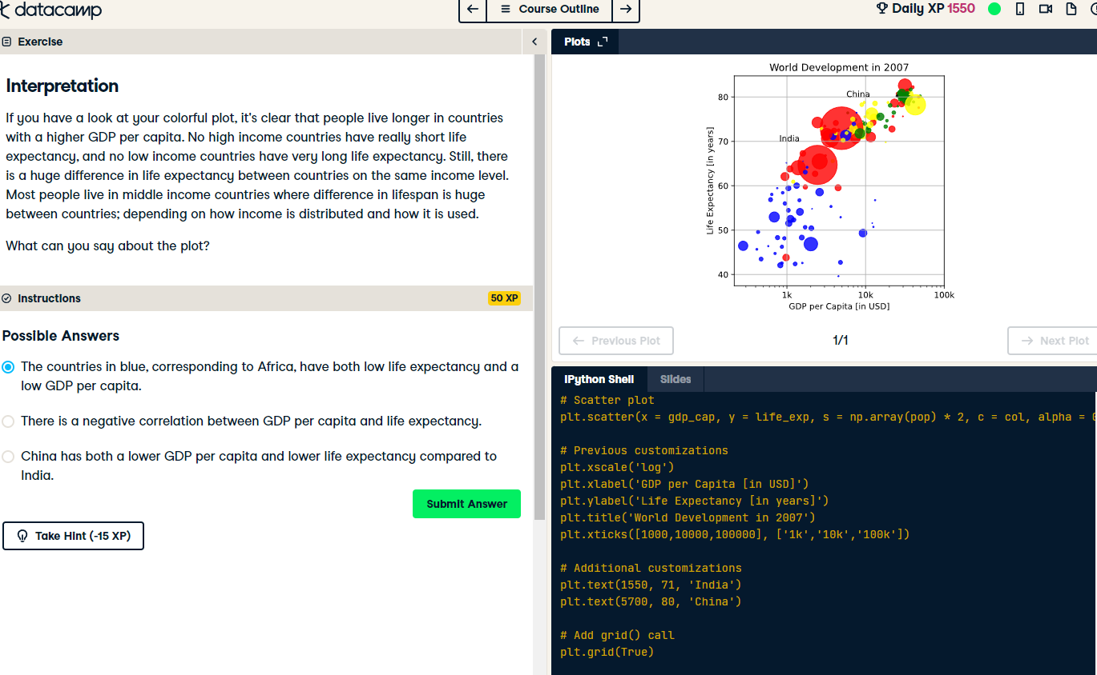

Slide 33
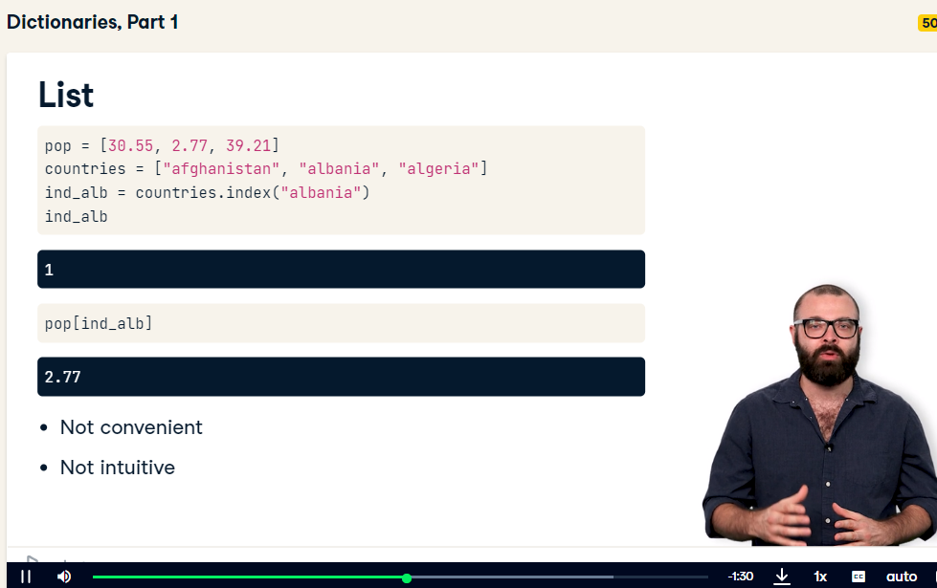

Slide 34
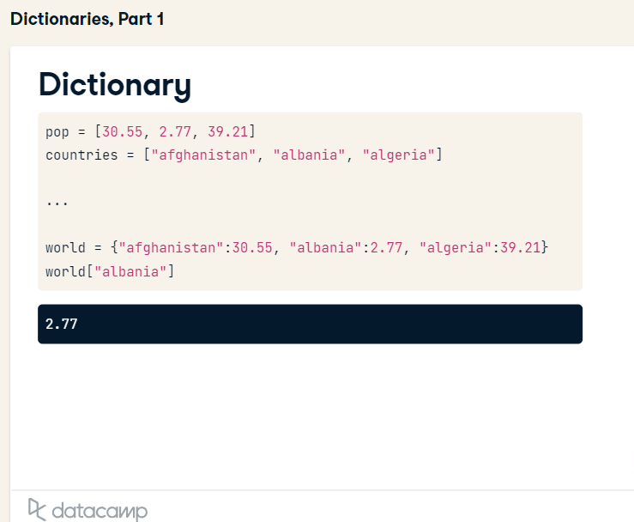

Slide 35
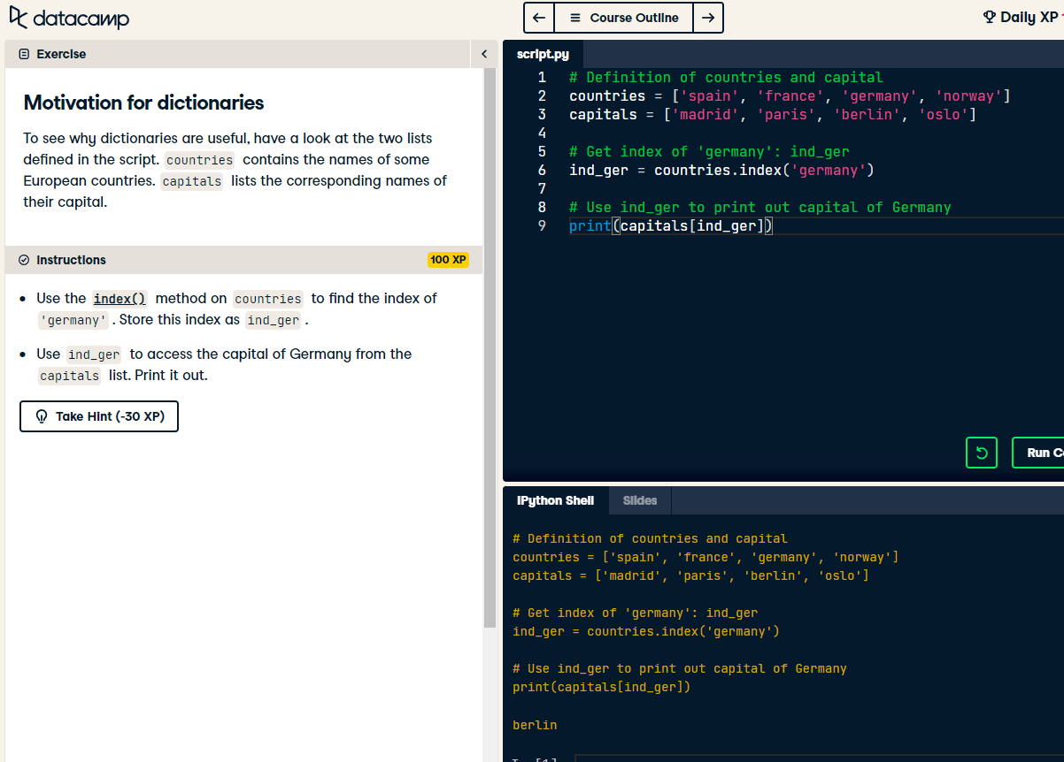

Slide 36
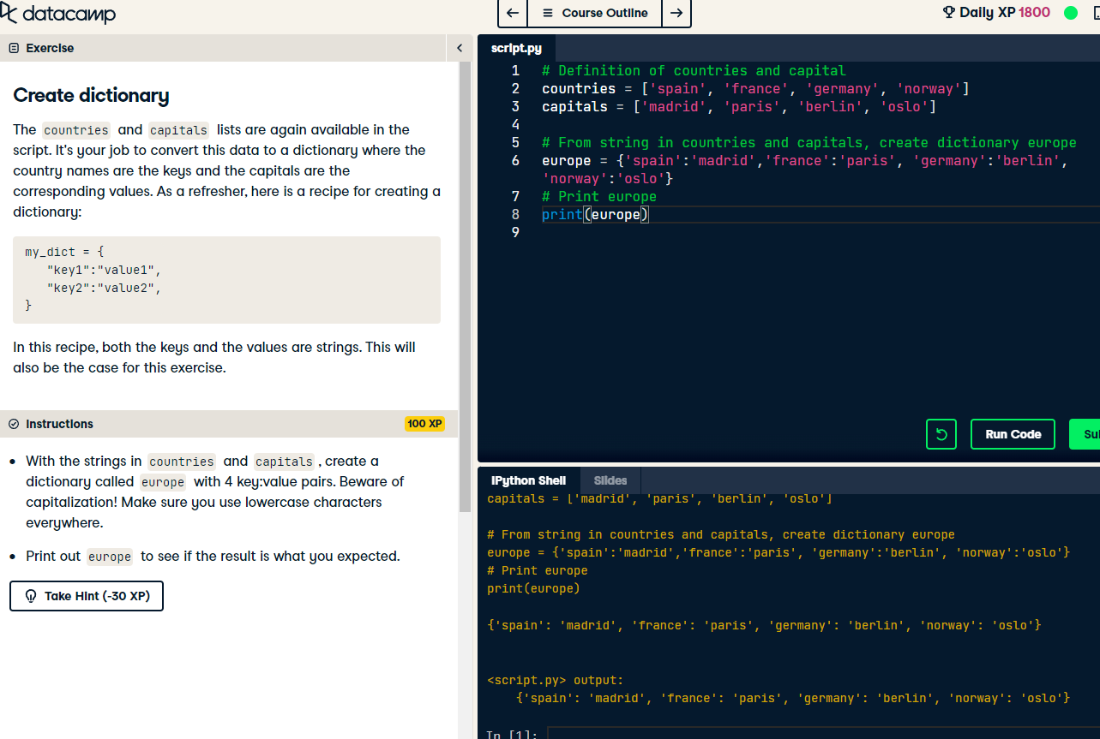

Slide 37
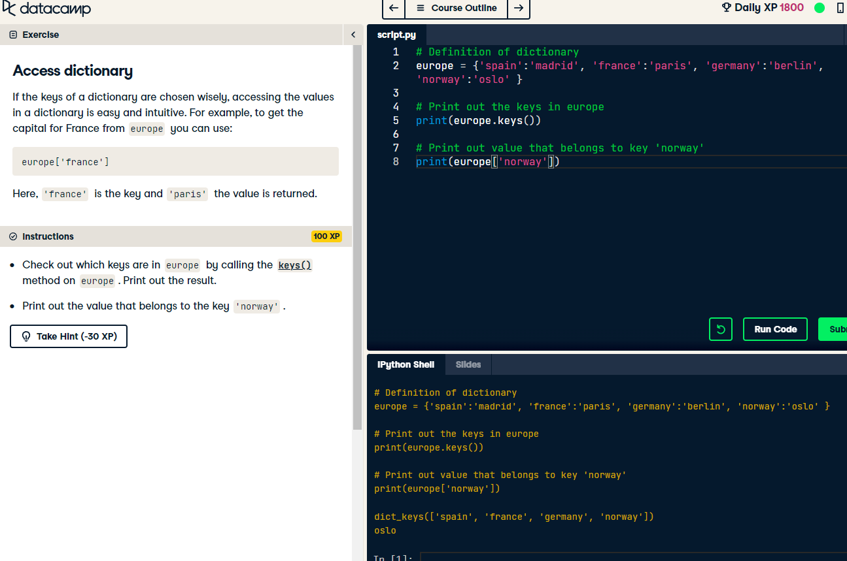

Slide 38
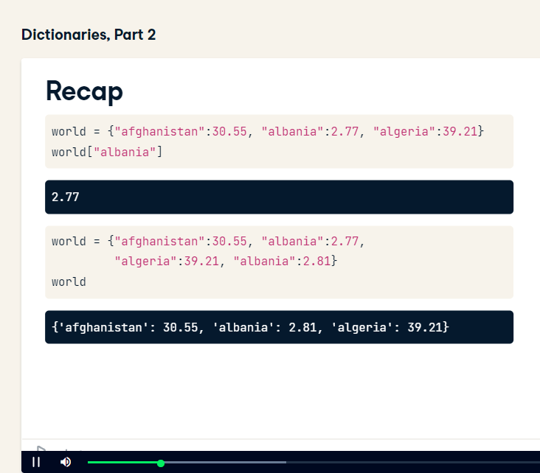

Slide 39
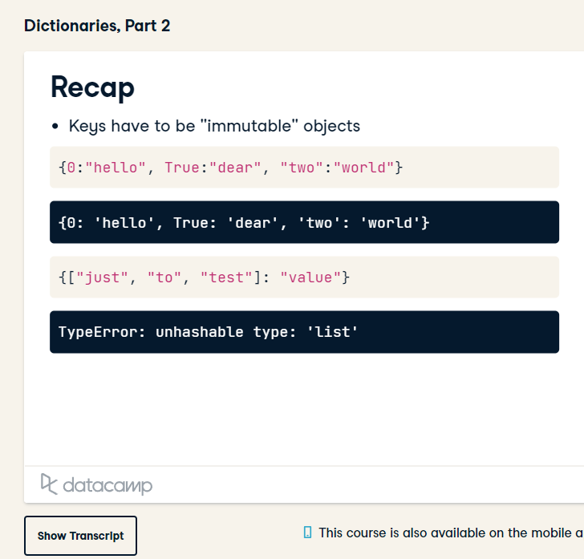

Slide 40
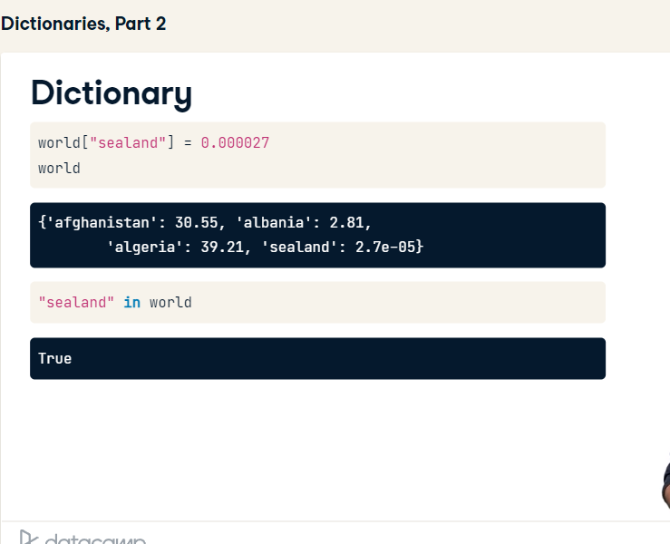

Slide 41
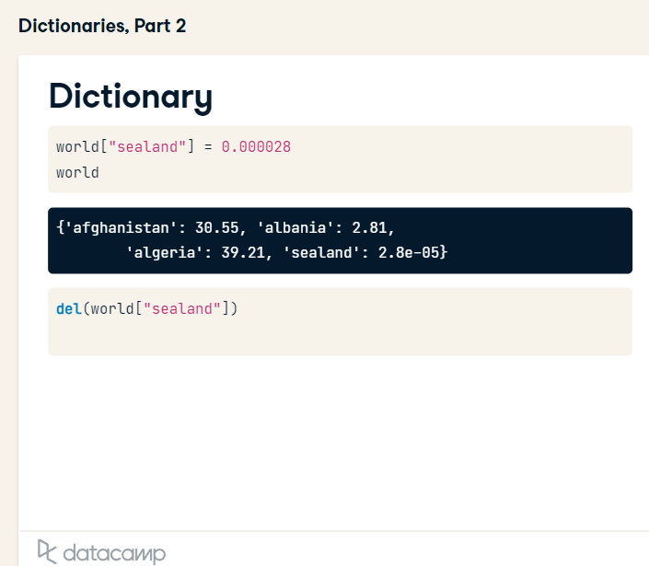

Slide 42
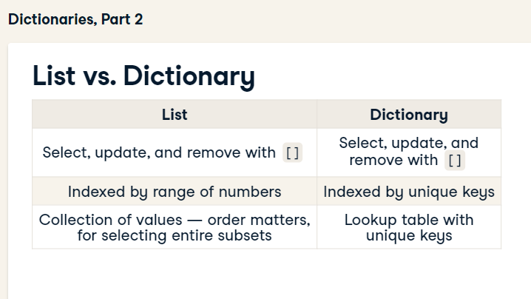

Slide 43
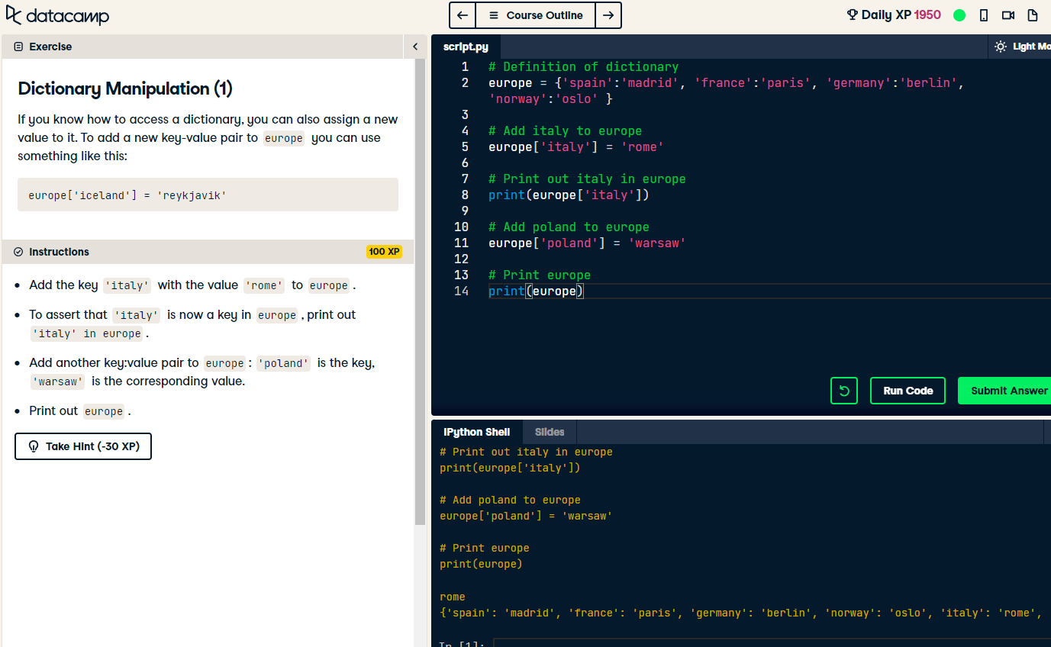

Slide 44
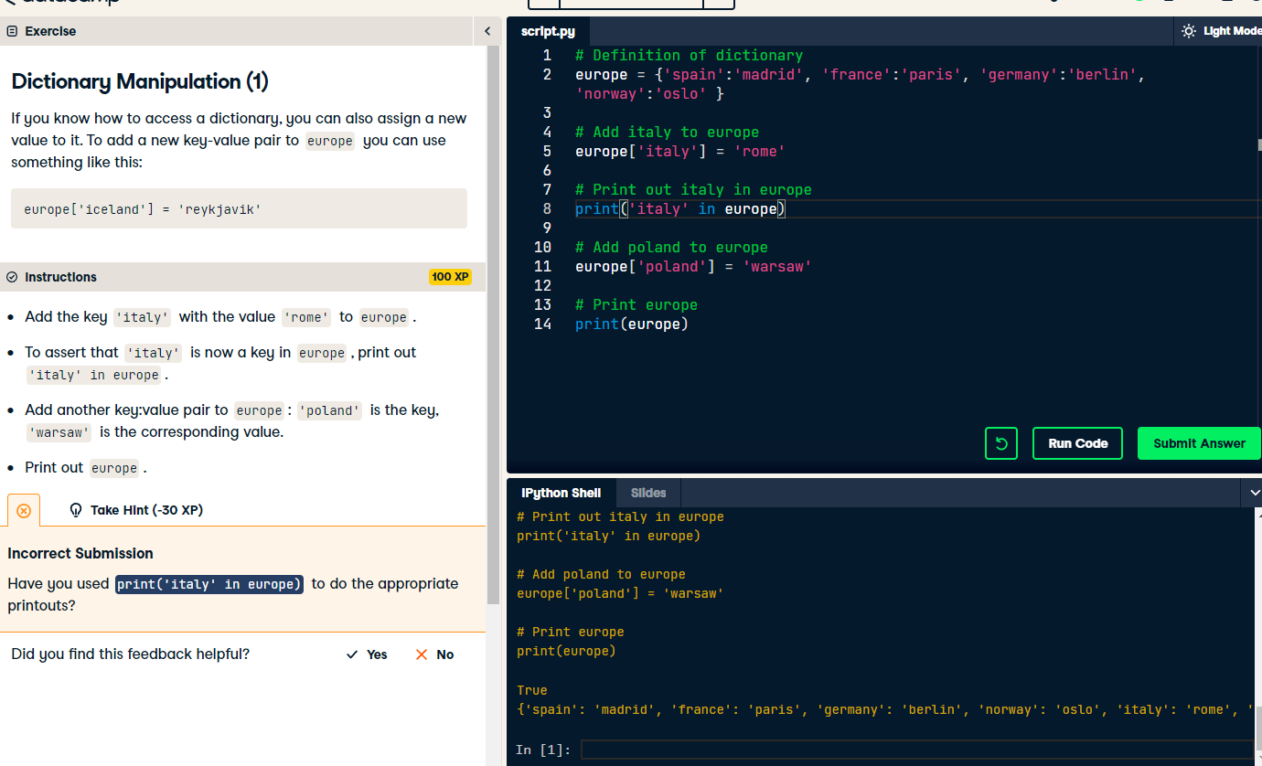

Slide 45
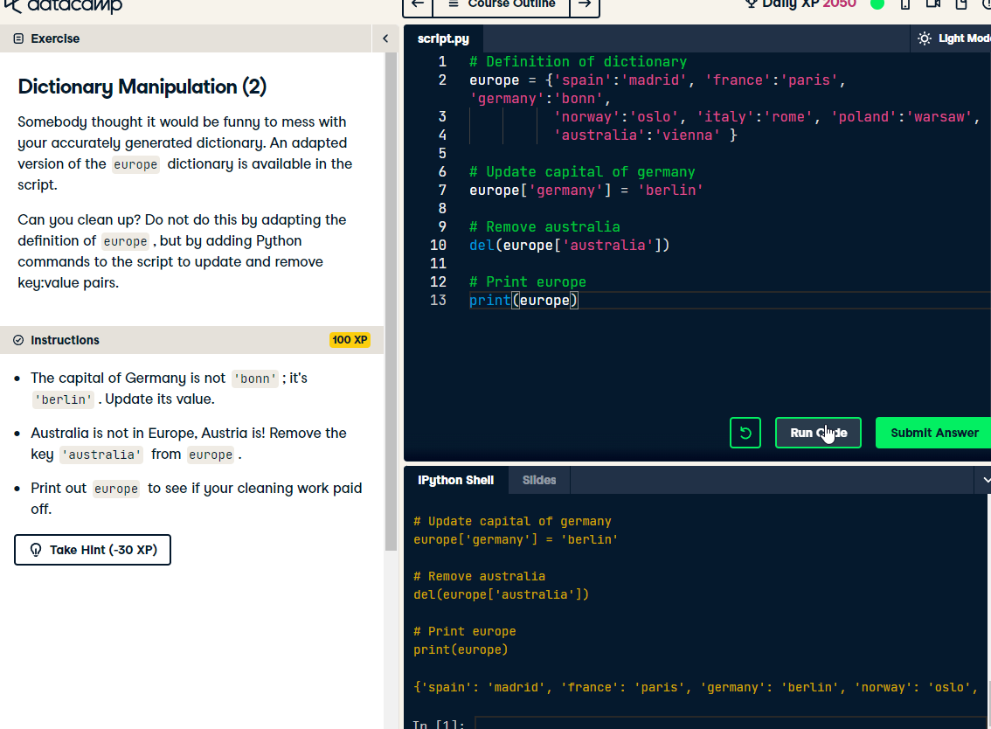

Slide 46
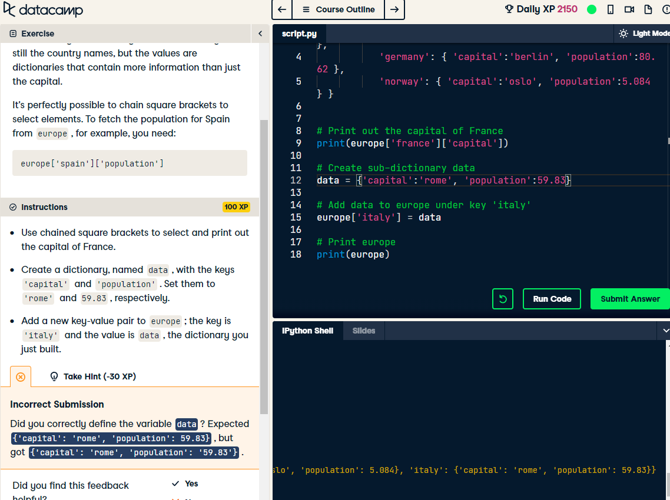

Slide 47


Slide 48
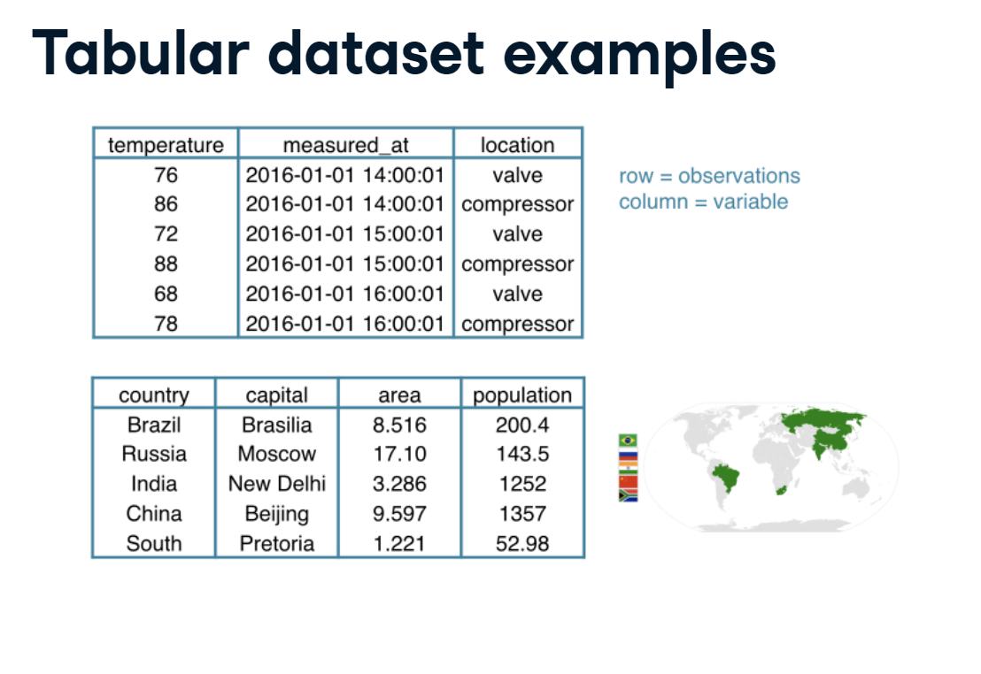

Slide 49
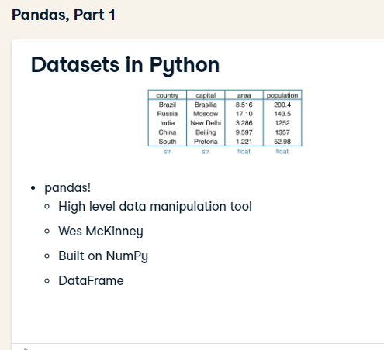

Slide 50
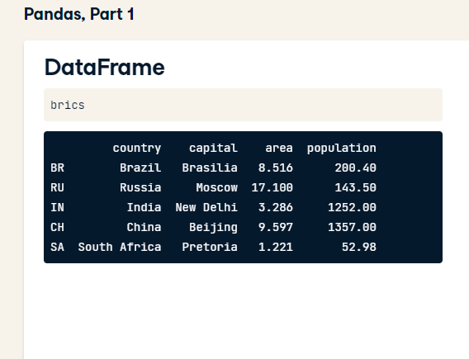

Slide 51
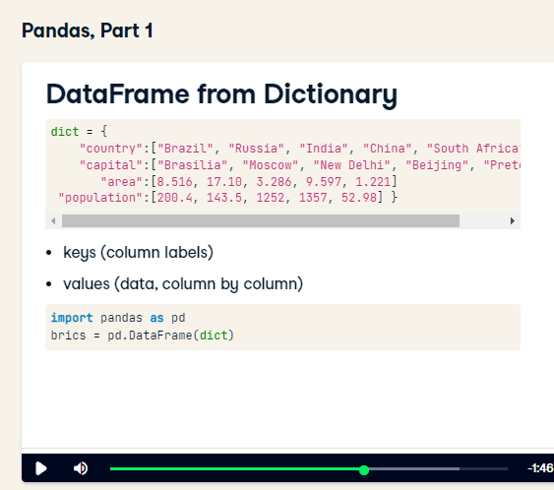

Slide 52
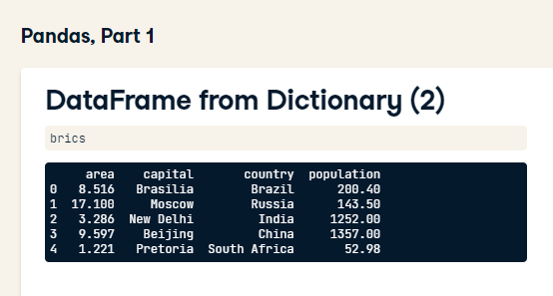

Slide 53
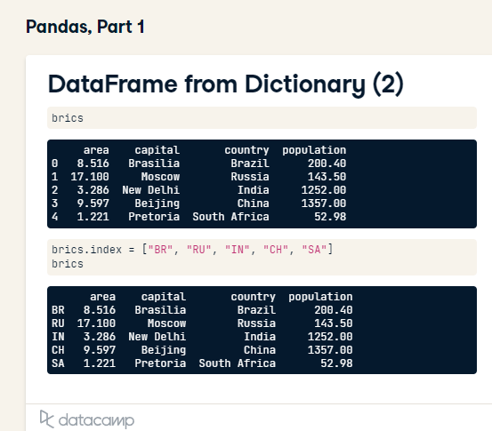

Slide 54


Slide 55


Slide 56


Slide 57



Slide 58


Slide 59


Slide 60


Slide 61


Slide 62



Slide 63


Slide 64


Slide 65


Slide 66


Slide 67


Slide 68


Slide 69


Slide 70


Slide 71


Slide 72


Slide 73


Slide 74


Slide 75


Slide 76


Slide 77


Slide 78


Slide 79


Slide 80


Slide 81


Slide 82


Slide 83


Slide 84


Slide 85


Slide 86


Slide 87

before
Compare with same type

Slide 88


Slide 89


Slide 90


Slide 91


Slide 92


Slide 93


Slide 94


Slide 95


Slide 96


Slide 97


Slide 98


Slide 99


Slide 100


Slide 101


Slide 102


Slide 103


Slide 104


Slide 105


Slide 106


Slide 107


Slide 108


Slide 109


Slide 110


Slide 111


Slide 112


Slide 113


Slide 114


Slide 115


Slide 116


Slide 117


Slide 118


Slide 119


Slide 120


Slide 121


Slide 122


Slide 123


Slide 124


Slide 125


Slide 126


Slide 127


Slide 128


Slide 129


Slide 130


Slide 131


Slide 132


Slide 133


Slide 134


Slide 135


Slide 136


Slide 137


Slide 138


Slide 139



Slide 140



Slide 141


Slide 142


Slide 143


Slide 144


Slide 145


Slide 146


Slide 147


Slide 148


Slide 149


Slide 150

The order of dictionary is no in ordered

Slide 151


Slide 152


Slide 153


Slide 154


Slide 155


Slide 156

Dictionary required a method
Numpy arrays use a function

Slide 157


Slide 158


Slide 159


Slide 160


Slide 161


Slide 162


Slide 163


Slide 164


Slide 165

Loc is label based
Ineffcient way!!!

Slide 166


Slide 167


Slide 168


Slide 169


Slide 170


Slide 171


Slide 172


Slide 173

Random seed

Slide 174


Slide 175


Slide 176


Slide 177


Slide 178


Slide 179


Slide 180


Slide 181



Slide 182



Slide 183


Slide 184

correct

Slide 185


Slide 186


Slide 187


Slide 188


Slide 189


Slide 190



Slide 191



Slide 192


Slide 193


Slide 194


Slide 195


Slide 196

EDA

Slide 197


Slide 198


Slide 199


Slide 200


Slide 201


Slide 202


Slide 203



Slide 204


Slide 205

Set bin edges by my self

Slide 206


Slide 207




Slide 208


Slide 209


Slide 210


Slide 211


Slide 212



Slide 213


Slide 214


Slide 215


Slide 216


Slide 217


Slide 218

Beeswam‘s problem have overlapping data points, which was necessary in order to fit all points onto the plot.

Slide 219


Slide 220


Slide 221


Slide 222


Slide 223


Slide 224


Slide 225


Slide 226


Slide 227


Slide 228


Slide 229


Slide 230


Slide 231



Slide 232


Slide 233


Slide 234


Slide 235


Slide 236

50% of the data are less than the median

Slide 237

Percentiles are used for summary statistics

Slide 238


Slide 239


Slide 240


Slide 241


Slide 242


Slide 243


Slide 244


Slide 245


Slide 246


Slide 247


Slide 248


Slide 249


Slide 250


Slide 251


Slide 252


Slide 253


Slide 254



Slide 255



Slide 256


Slide 257


Slide 258


Slide 259


Slide 260


Slide 261


Slide 262


Slide 263


Slide 264

Mean of these differences

Slide 265


Slide 266

Range [-1,1]

Slide 267

Pearson correlation coefficient is a good metric for correlation between two variables.

Slide 268


Slide 269


Slide 270


Slide 271


Slide 272


Slide 273


Slide 274


Slide 275


Slide 276


Slide 277


Slide 278


Slide 279

Seed random number gernerator
Draw 4 random numbers

Slide 280


Slide 281


Slide 282


Slide 283


Slide 284


Slide 285


Slide 286


Slide 287


Slide 288


Slide 289


Slide 290


Slide 291


Slide 292


Slide 293


Slide 294


Slide 295


Slide 296


Slide 297


Slide 298


Slide 299


Slide 300


Slide 301


Slide 302


Slide 303


Slide 304


Slide 305


Slide 306


Slide 307


Slide 308


Slide 309


Slide 310


Slide 311


Slide 312


Slide 313


Slide 314

Probability is given by the area under the ‘PDF’, not the value of the PDF

Slide 315


Slide 316


Slide 317


Slide 318



Slide 319


Slide 320

Normal PDF

Slide 321

Normal CDF

Slide 322


Slide 323

Which is normal distribution

Slide 324


Slide 325


Slide 326


Slide 327


Slide 328


Slide 329


Slide 330


Slide 331


Slide 332



Slide 333


Slide 334


Slide 335


Slide 336


Slide 337



Slide 338


Slide 339


Slide 340


Slide 341


Slide 342


